Slide 1


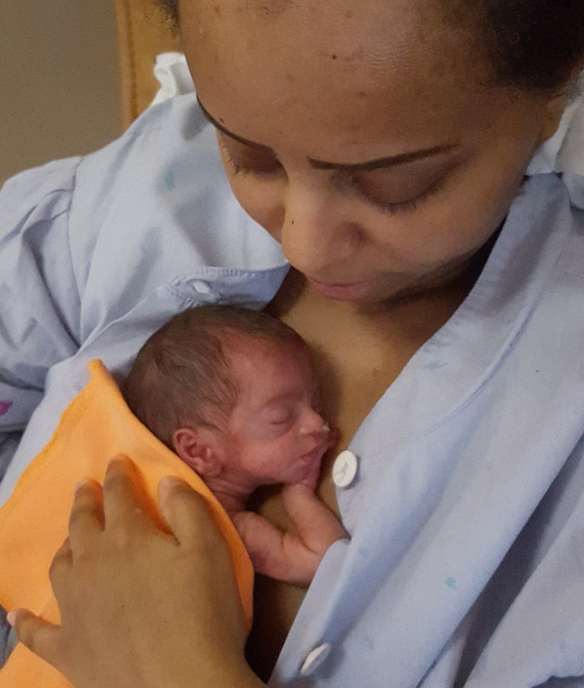
17th Swedish Conference on Ultra-Early Intervention
Infant- and Family-Centered Developmental Care
for every newborn everywhere
A Global Perspective
Online March 12, 2027
Speakers: Nathalie Charpak, Harish Chellani, Graciella Basso,
Christina Tischer and more!
Registrations will open in December

